Slide 1
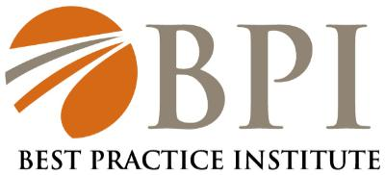
Integrated Talent Management Research
Best Practice Institute, March 21, 2012

Slide 2

Contents
  Introduction
  History of Talent Management
  Trends in Integrated Talent Management
  The Evolution of Talent Management Models
  BPI’s Integrated Model
Best Practice Institute

Slide 3
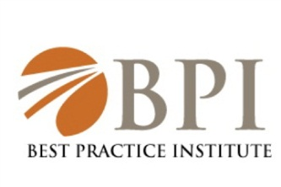



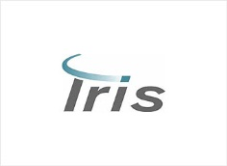




Best Practice Institute is One of Today’s Most Active and Open HR Associations
  BPI Capabilities and Offerings
Memberships
General membership
Offerings
On demand Research
Key Areas
Talent Management
Action Councils
Corporate Membership
Organizational Change Efforts
Online Learning for over 30 Skills and Competencies
Benchmark Presentations
Best Practice Case Studies
Network of over 42,000
Organization Transformation
Global Leadership Development
Integrated Talent Management
Global Recruitment
Best Practice Organization
Access to Experts in All Key Areas
Provide Top Research and Learning to organization
Benchmark with peer Fortune 500 Organizations
Become a part of a close community who values best practices and knowledge sharing
Large and Small Group Transformation Meetings & Consulting
Best Practice Institute

Slide 4
Talent Management has its Roots in OD, the Competency Movement, Assessment Processes and Succession Planning, as They Apply to Identifying, Ranking and Moving People
Henri Fayol, French pioneer in management history, documented universal need for succession planning in 1917
1945 - First non-military use of assessments - British Civil Service Assessment
1973 David McClelland’s Testing for Competence
1920-1930’s Tests and Job Simulations to measure “Leadership”
1959 Peter Drucker introduces term and concept of “Knowledge Worker”
1998 Term “Talent Management” first used by David Watkins at Softscape
Industrial Revolution-Plans for Leadership Change in order to protect business
1914-1918 First Test Used for Selection in WWI
1940's - British War Office Selection Boards - Interviews, tests, simulations
1956-1980’s AT&T Management Study: Interviews, Business games, personal history
1970 Ed Shein;s work in Organizational Effectiveness
1997 “The War for Talent” first used by Steven Hankin of Mckinsey
2009 Best Practices in Talent Management with Lou Carter, Marshall Goldsmith & BPI
“The requirements for leadership are continually evolving, making it imperative that practices in talent management evolve to meet the changing needs of leadership.”- Heidrick & Struggles
Best Practice Institute

Slide 5
BPI’s Research Methodology Provided a Deep Dive Into Current Talent Management Practices
Research Methodology
ITM Study
Review of Literature
Targeted Surveys of Global
Companies
In Depth Case Studies
Vendor Trend Analysis
Input From TM & Corporate HR Experts
BPI Spoke with Over 100 Executives Regarding Their Organization’s Work in Integrated Talent Management
Best Practice Institute

Slide 6
Integrated Talent Management is the Process of Bringing People, Processes and Operations Together
INTRODUCTION
Processes
Succession Planning
Operations
Job Design
Transformation
Organizational
People
Learning & Development
Talent Acquisition
Workforce Planning
Compensation & Benefits
Performance Management
Corporate Executives
VP Talent Management
HR Departments
Line Organizations
Frontline Employees
Functional
Salary Structures
HRIS
Data Sharing
Policy/Procedure
Cultural
Whole Systems
Best Practice Institute

Slide 7
BPI Identified 8 Critical Success Factors That Organizations are Leveraging to Integrate Talent Management
Critical Success Factors
Let the Business Drive the Need
Integrate with Culture
Gain Executive Sponsorship
Involve the Line and IT
The Team is Critical
Focus, Process and Project Management are Required
Develop Common Language
Train, Maintain, Sustain and Show Value
“If the Business isn’t Asking for it, Don’t Do it!” – E.W. Scripps
Best Practice Institute

Slide 8
Alignment of Employee and Organizational Goals with the Business Strategy Was the Number One Factor for Initiating Integration of Talent Management Strategies in Organizations
Factors that Lead to Integrating Talent Management Strategies
Percentage of Organization Need for ITM
Best Practice Institute

Slide 9
We Found That Majority of Organization’s Are Integrated Talent Management Through the Human Resources Division
Division Leveraged To Drive ITM Initiatives
High frequency
Human Resources
VP of Talent Management
C-Level Executive
Director of Talent Management
Director of HR Operations
Director of Organization Capability/Development
Research & Development
IT Department
*Others listed were Board of Directors and Training Department
Low
frequency
Destination leveraged the Directors of HR in each business location as change advocates for end users; it was critical that senior executives called for and supported the ITM initiative
Best Practice Institute

Slide 10
We Found That Vendor Selection and Identification of Main Areas of Focus Are The Top Critical Success Factors for ITM
Top Areas Organizations Identified to be Integrated
Career & Competency Management
Talent Development Management
Performance Management
Analytics & Reporting
Succession Planning
Goal Management
Talent Acquisition/Recruiting Management
Learning System Management
When Choosing a Focus Area for Integration It is Important to Keep Your Business Strategy at the Center of Your Decision
Best Practice Institute

Slide 11
We Found That Organizations are Trending Towards Full Integration of All Talent Systems
Integration of Talent Management Systems
Talent Acquisition
Performance Management
Succession Planning
Workforce Planning
Learning & Development
Compensation & Benefits
Feedback/Measurement
Retention
Best Practice Institute

Slide 12
Continued…
Integration of Talent Management Systems
27% of the Organizations have Fully Integrated Performance Management
49% of Organizations see the need and have begun Integrating Workforce Planning
25% of Organizations have not begun integrated Succession Planning at all
44% of Organizations are beginning to integrate Talent Acquisition
33% of Organizations are beginning to Integrate Succession Planning
51% of Organizations have Somewhat Integrated Feedback
Best Practice Institute

Slide 13
We Found That Organizations Still Rely Heavily on Internally Developed Systems for Their Talent Management Processes
Percentage of Use
“In the quest to integrate, processes will be adjusted, expensive customizations will be added, process pieces will go offline, or a combination of these will take place. You must remain proactive.” - CDW
Best Practice Institute

Slide 14
Organizations That Have Access To Meaningful Data and Implement User Friendly Systems Are More Likely To Win At Integration
Top 7 Indicators of Integration Success
Ease of Use
Access To Meaningful Data
Alignment with Business Strategy
Employee Engagement
Linkage of Strategy, Execution and Talent
Cultural Transformation
Management Commitment to Developing People
“Implementing appropriate talent management systems that would meet the company’s talent needs and optimize the likelihood of successful adoption by employees at all levels, defines success of our ITM Strategy”- E.W. Scripps
Best Practice Institute

Slide 15
Quality and Use of Data from TM Systems Has Lead Organizations to Focus on Other TM Processes and Additional Integration
Results of Integrating Talent Management
High Employee Engagement
Talent Referral Programs
Increase of Cross Functional Moves
Better Succession Planning Management
Retention Programs
Best Practice Institute

Slide 16
MODEL
Talent Management Models Began As Structured and Functional Models, Reflecting the Different Parts of Talent Processes
Talent Management Model, Circa 2007
Sustainable
Competitive
Advantage
ORGANIZATIONAL
STRATEGY
IMPROVED
PERFORMANCE
Selection
System
Succession
Management
System
Talent
Strategy
Talent
Architecture
Superior
Talent
Performance
& Reward
System
Leadership
Development
System
RESEARCH BASED FOUNDATION
Best Practice Institute

Slide 17
MODEL
By 2008, Succession Planning and Performance Modeling Processes Began Its Integration With Other Business and Talent Management Processes
Succession Management Overview
Current Status
Future Challenges
Key Roles
Strategic Business Analysis
Performance Modeling for Key Roles
Senior
Middle
Entry
Staff
Recruitment
and
Orientation
Early
Identification
and
Preparation
Talent
Pool
Development
Talent
Pool
Readiness
Candidate
Selection
and
Placement
Data Management
Talent Review Process
Tools & Training
Progress Measurement
System Management & Support
Best Practice Institute

Slide 18
Models Continue to Evolve, Incorporating More TM and Business Processes
Best Practices in Talent Management 2011
Business Complexity
New Markets
Accelerated
Development
ORGANIZATIONAL
STRATEGY
Sustainable
Competitive
Advantage
IMPROVED
PERFORMANCE
ORGANIZATIONAL
STRATEGY
IMPROVED
PERFORMANCE
Selection System
Succession Management System
Business
Constraints
Talent Architecture
Workforce
Planning
Talent Strategy
Superior Talent
Improved
Business
Results
Performance and Reward System
Leadership Development System
Speed
Agility
Engagement
Scenario Planning/Planned Improvisation
RESEARCH BASED FOUNDATION
HR Analytics
Best Practice Institute

Slide 19
MODEL
Based on our Recent Research, BPI Designed a Model That Addresses Integrated Talent Management from a Business Strategy Standpoint
Elements of BPI Integrated Talent Management Model
Learning
&
Development
Workforce
Planning
Talent Acquisition
Business
Strategy
Comp
&
Benefits
HR Technology
Succession
Planning
Performance
Management
Organizational Structure
Best Practice Institute

Slide 20
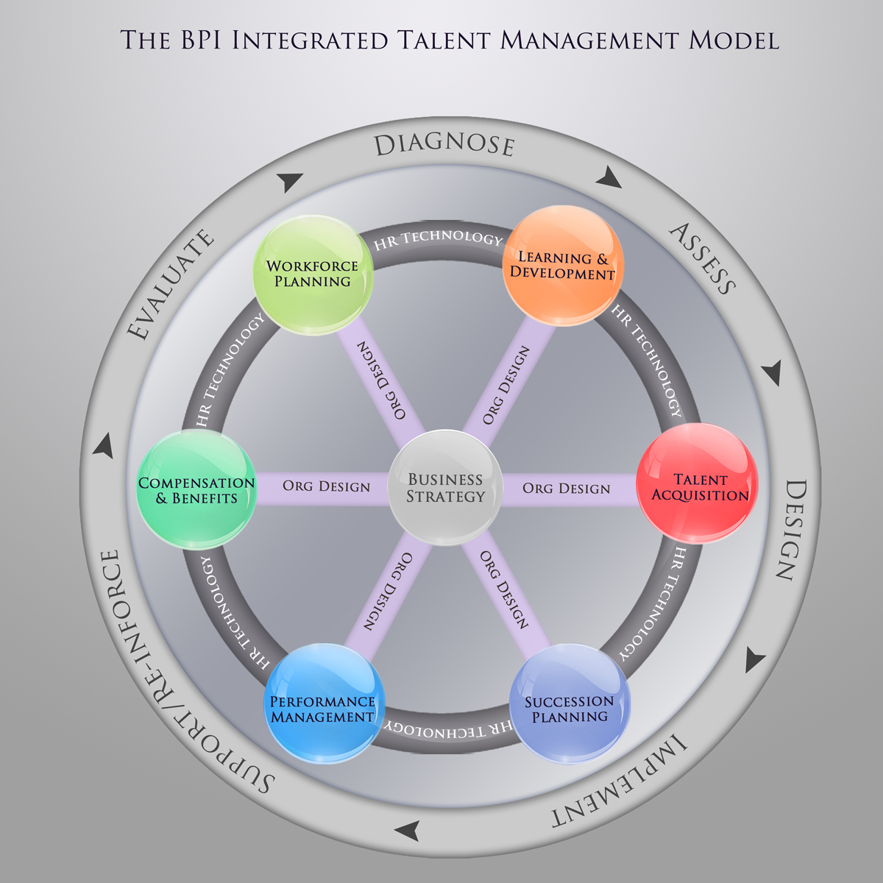
Best Practice Institute

Slide 21
For Future Research and Analysis
Issues Still Causing Headaches
Is integration working? How do we know?
Is such work meeting a critical business need? Prove it
What are our key internal customers saying? Are they pleased?
Is this work adding value? Show us how and where
By integrating our people processes, have we improved organizational alignment?
Do we have the right workforce plan for our business requirements?
Are we making the most of our internal labor market?
“We look forward to the day when we achieve “talent-at-a-glance” functionality. We envision talent intelligence at our fingertips and in real time.” - CDW
Best Practice Institute

Slide 22
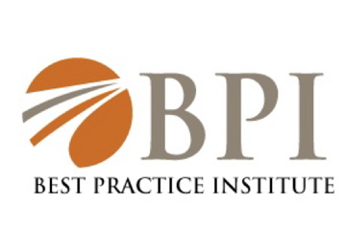
Questions?
Pdcarmichael@bestpracticeinstitute.org
Best Practice Institute

